Slide 1







A COMPUTER ASSITED REVIEWER
FOR PUBLIC & PATIENT INVOLVEMENT
Fernando Santos | Prof Jeremy Wyatt | University of Southampton
WEB ANALYSIS
MEDICINE:
WEB ANALYSIS
MEDICINE:
Search
Engines
Public Involvement
Ranking
Automation
Patient Comments
Content Analysis
Sentiment Analysis
Clustering
Good writing insights
CARPPI
SYSTEM
Text Vectors
Is this a good comment?
What factors can affect the quality of a leaflet?
Is this comment relevant to other leaflets?
Is this text different from what it’s normally read?

Slide 2





A COMPUTER ASSITED REVIEWER
FOR PUBLIC & PATIENT INVOLVEMENT
Fernando Santos | Prof Jeremy Wyatt | University of Southampton
WEB ANALYSIS
MEDICINE:
WEB ANALYSIS
MEDICINE:
Public Involvement
Search Engines
Automation
Ranking
Patient Comments
Content Analysis
Good Writing Insights
Sentiment
Analysis
Text Vectors
CARPPI
SYSTEM
Clustering
Is this a good comment?
What factors can affect the quality of a leaflet?
Is this comment relevant to other leaflets?
Is this text different from what it’s normally read?

Slide 3
A COMPUTER ASSITED REVIEWER
FOR PUBLIC & PATIENT INVOLVEMENT
Fernando Santos | Prof Jeremy Wyatt | University of Southampton
WEB ANALYSIS
MEDICINE:
WEB ANALYSIS
MEDICINE:
Public Involvement
Search Engines
Automation
Ranking
Patient Comments
Content Analysis
Good Writing Insights
Sentiment
Analysis
Text Vectors
CARPPI
SYSTEM
Clustering
Is this a good comment?
What factors can affect the quality of a leaflet?
Is this comment relevant to other leaflets?
Is this text different from what it’s normally read?

Slide 4



A COMPUTER ASSITED REVIEWER
FOR PUBLIC & PATIENT INVOLVEMENT
Fernando Santos | Prof Jeremy Wyatt | University of Southampton
WEB ANALYSIS
MEDICINE:
Search Engines
Public Involvement
Automation
Ranking
Patient Comments
Content Analysis
Sentiment
Analysis
Good Writing Insights
Text Vectors
CARPPI
SYSTEM
Clustering
Is this a good comment?
What factors can affect the quality of a leaflet?
Is this comment relevant to other leaflets?
Is this text different from what it’s normally read?

Slide 5
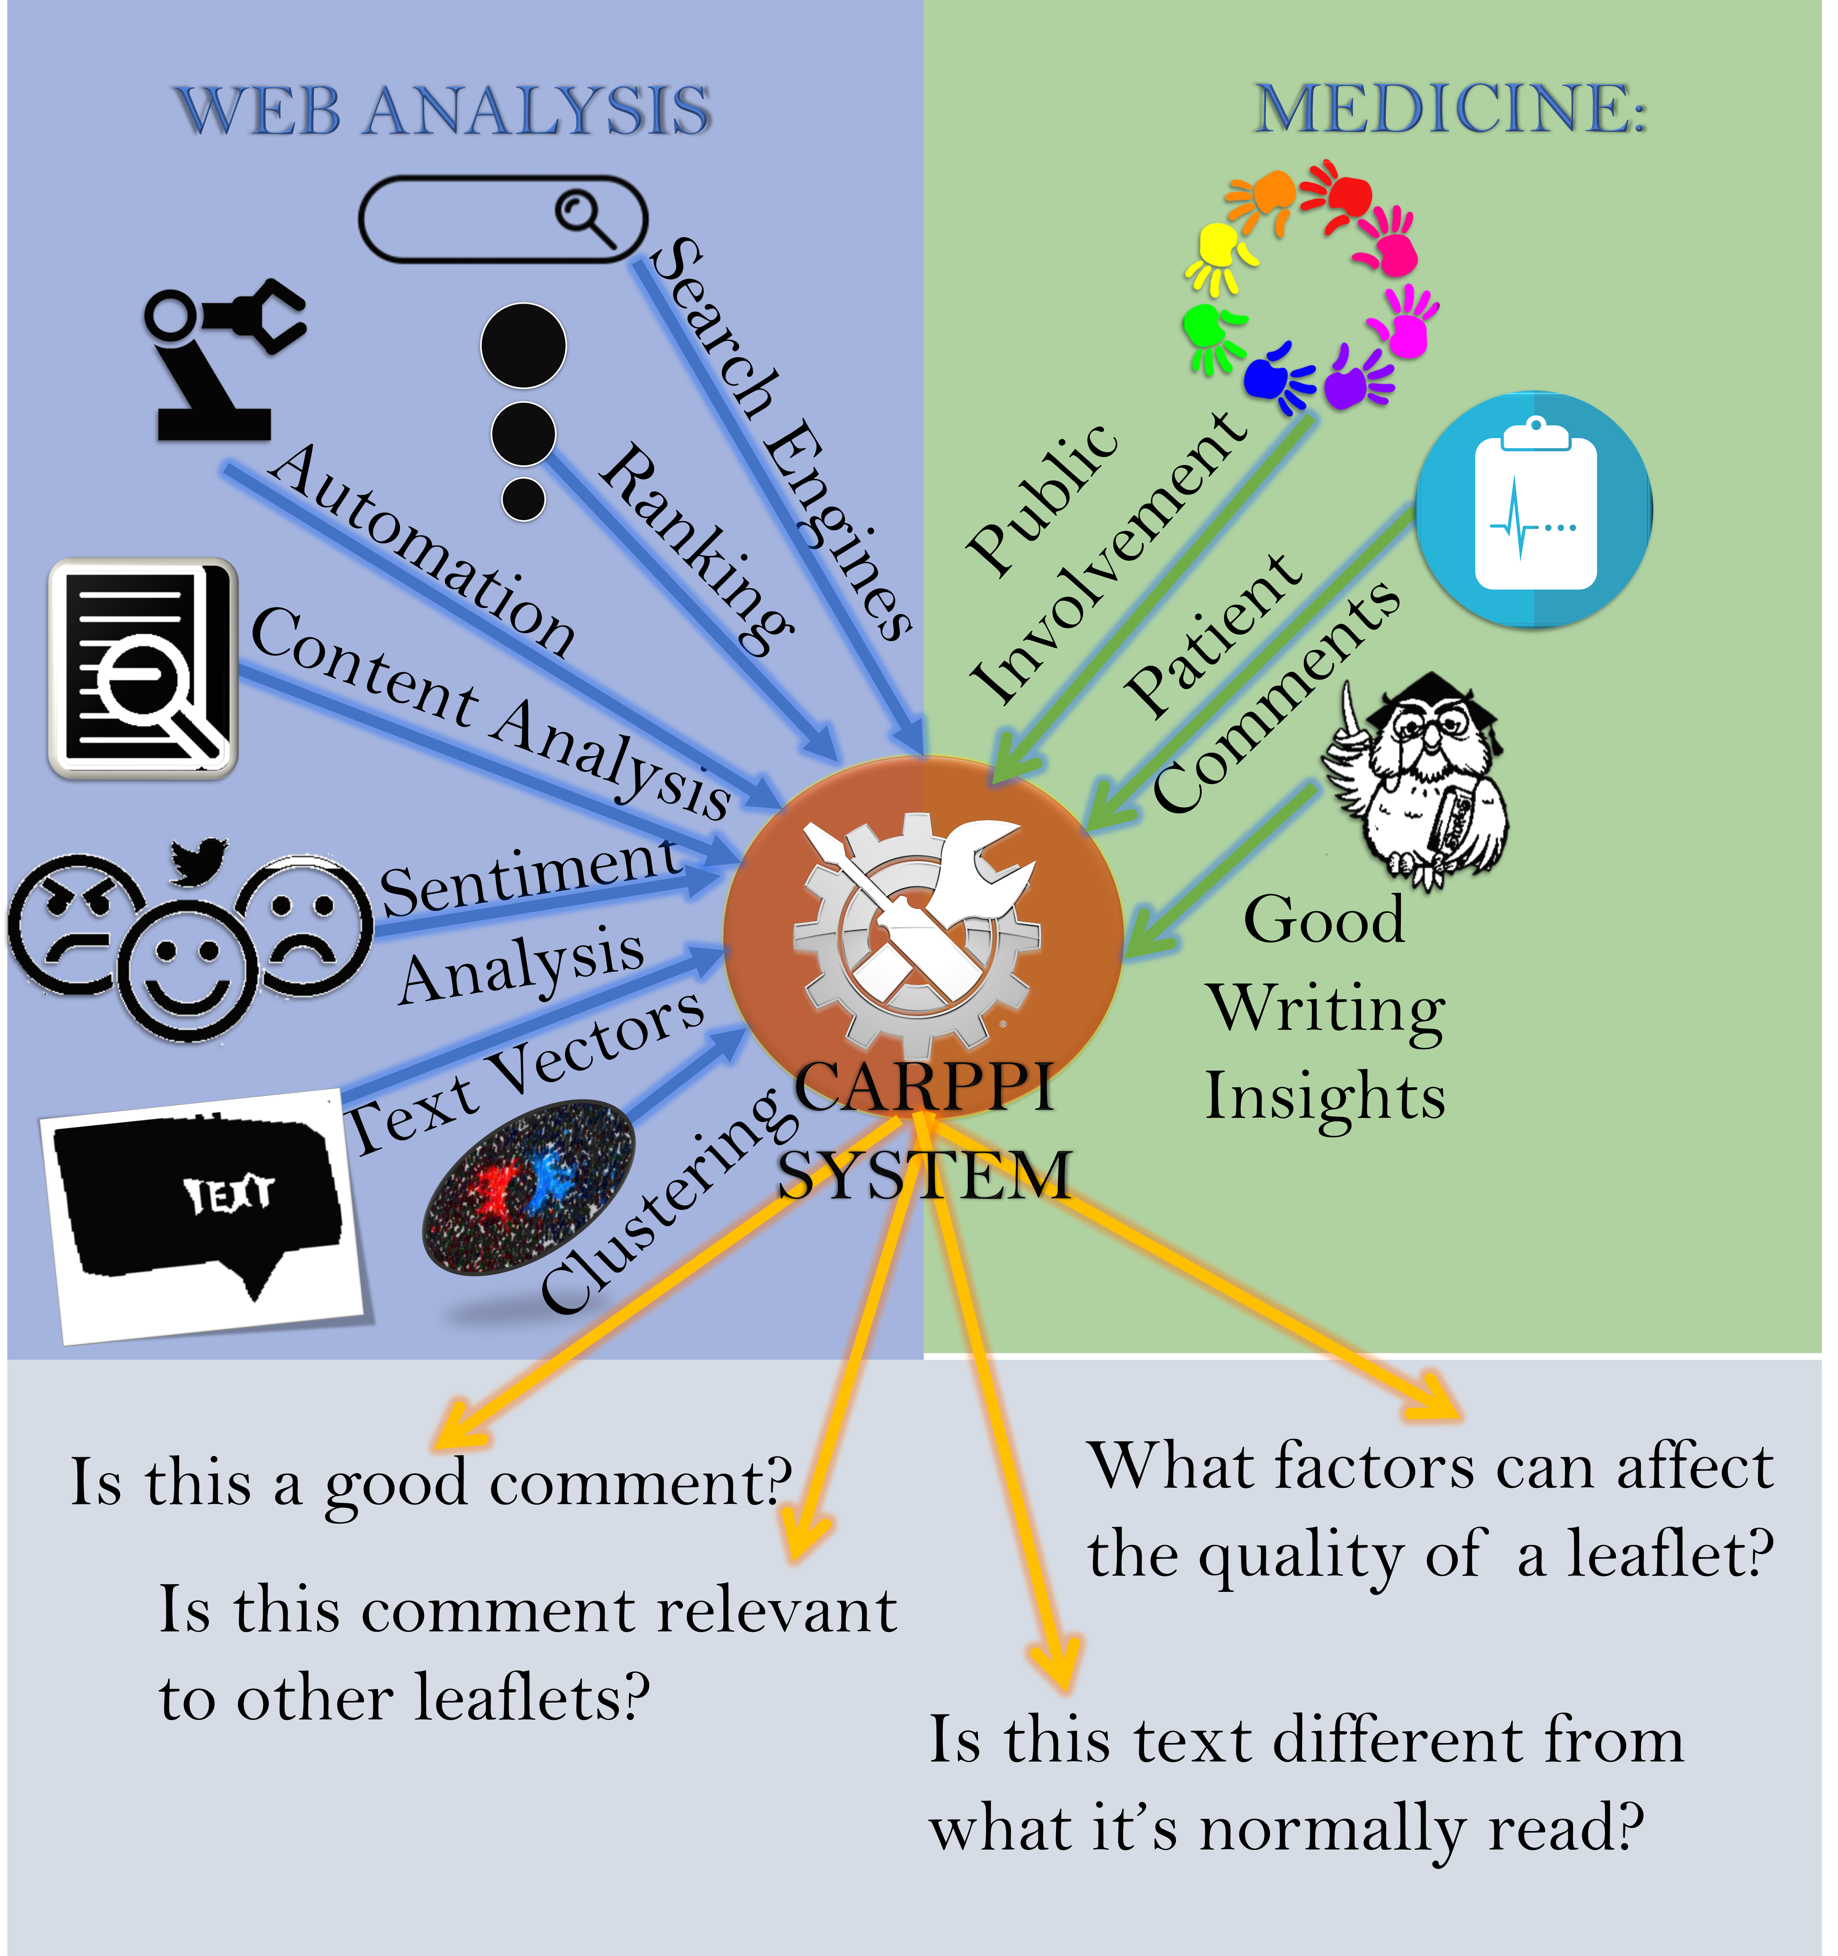
A COMPUTER ASSITED REVIEWER
FOR PUBLIC & PATIENT INVOLVEMENT
Fernando Santos | Prof Jeremy Wyatt | University of Southampton
Introduction
Currently, there appears to be no quantitative assessment of
The impact PPI groups have on the quality of the RCT leaflets .
The leaflets’ capabilities to inform
the impact the leaflet has on patient decisions and consent
The effect of the leaflet on the trial recruitment and retention process.
Research Diagram
Research Questions
Is the leaflet quality affected by the PPI comments?
How can we evaluate the effect of a PPI comment?
Is the quality of the leaflet enough to enable a meaningful decision?
Proposal
My proposal is to create a system that permits the assessment of the effect PPI comments have on the quality of the leaflets and evaluate the leaflets’ impact on the trials’ recruitment and retention rates. To do this, I employ techniques used in the analysis of Web text to identify parts of the leaflets that are similar to previously commented sections, and follow the effects of each comment on the quality of new leaflets..
Identified Issues
PPI groups are small (3-7 people).
Public involvement is expensive, £25 per Hr and £200 - £400 per session.
PPI comments are not stored.
The final leaflet quality is not commonly assessed.
PPI officers believe PPI members should not be treated as participants.
Many researchers have found that the language is too hard to enable meaningful consent.

Slide 6
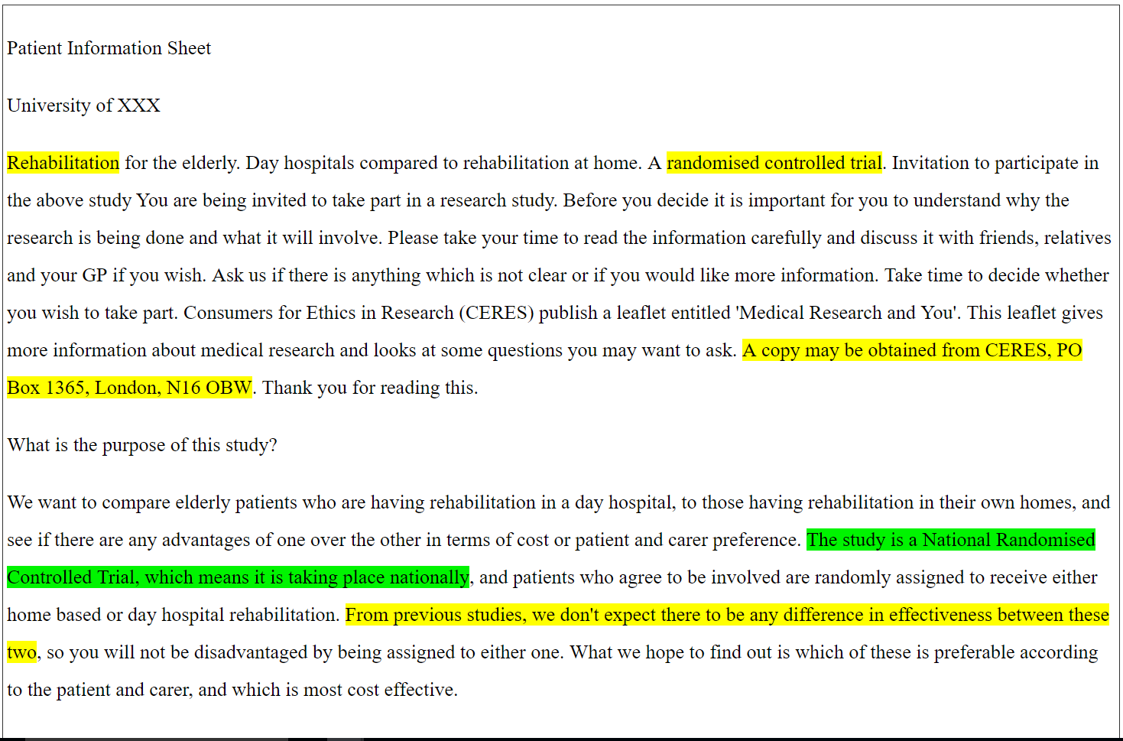
A COMPUTER ASSITED REVIEWER
FOR PUBLIC & PATIENT INVOLVEMENT
Fernando Santos | Prof Jeremy Wyatt | University of Southampton
Introduction
Currently, there is no standardized assessment of
The impact PPI groups have on the quality of the RCT leaflets .
The leaflets’ capabilities to inform
the impact the leaflet has on patient decisions and consent
The effect of the leaflet on the trial recruitment and retention process.
Prototype v1.0
Initial Results
Significant correlation between age group and reviewers’ quality grade
Significant correlation between education level and the percentage of correct answers
Significant correlation between number of specific comments and the percentage of correct answers
Research Questions
Is the leaflet quality affected by the PPI comments?
How can we evaluate the effect of a PPI comment?
Is the quality of the leaflet enough to enable a meaningful decision?
Proposal
My proposal is to create a Web platform that permits the assessment of the effect PPI comments have on the quality of the leaflets and evaluate the leaflets’ impact on the trials’ recruitment and retention rates. To do this, I employ techniques used in the analysis of Web text to identify parts of the leaflets that are similar to previously commented sections, and follow the effects of each comment on the quality of new leaflets..
Identified Issues
PPI groups are small (3-7 people).
Public involvement is expensive, £25 per hour and £200 - £400 per session.
PPI comments are not stored.
The final leaflet quality is not commonly assessed.
PPI officers believe PPI members should not be treated as participants.
Many researchers have found that the language is too hard to enable meaningful consent.

